Slide 1
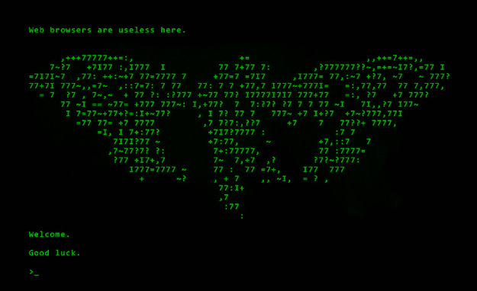
Cracking Cicada 3301
The Future of Collaborative Puzzle-Solving
A CicadaSolvers Production
By Taiiwo, Artorias, Puck, and Clockwork
Notes:
Hello and welcome
Say title
Introductions

Slide 2
What is Cicada 3301 and Who are we?
Cicada 3301
Mysterious international organization that released a series of increasingly difficult cryptographic puzzles.
The current step of the 2014 puzzle, a digital book of runes called Liber Primus, has gone unsolved.
CicadaSolvers
The main community of people interested in the Cicada 3301 puzzles.
Speakers
Puck - Community Organizer
Taiiwo - Technologist
Artorias - Archivist
Clockwork - Server Engagement
Notes:
Puck speaker notes:
3301‘s entrance - 2012 puzzle
3301- international group: liberty, privacy, security
2014’s unsolved Liber Primus
Not affiliated with 3301
we are members of CicadaSolvers, the mainly-discord community of active solvers
Intros:
Taiiwo - I’m Taiiwo. I cover the more technical roles within community such as administration, tool building, and also the overall community direction. I’ve been actively involved since 2013; I have grown a lot as a direct result of exposure to these puzzles, and I want to try to expand their influence to anyone who is willing to learn. And if we happen solve the Liber Primus somewhere along the way, that’s just a plus.

Slide 3
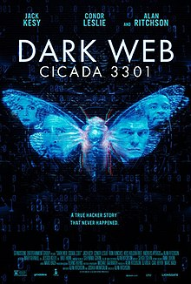
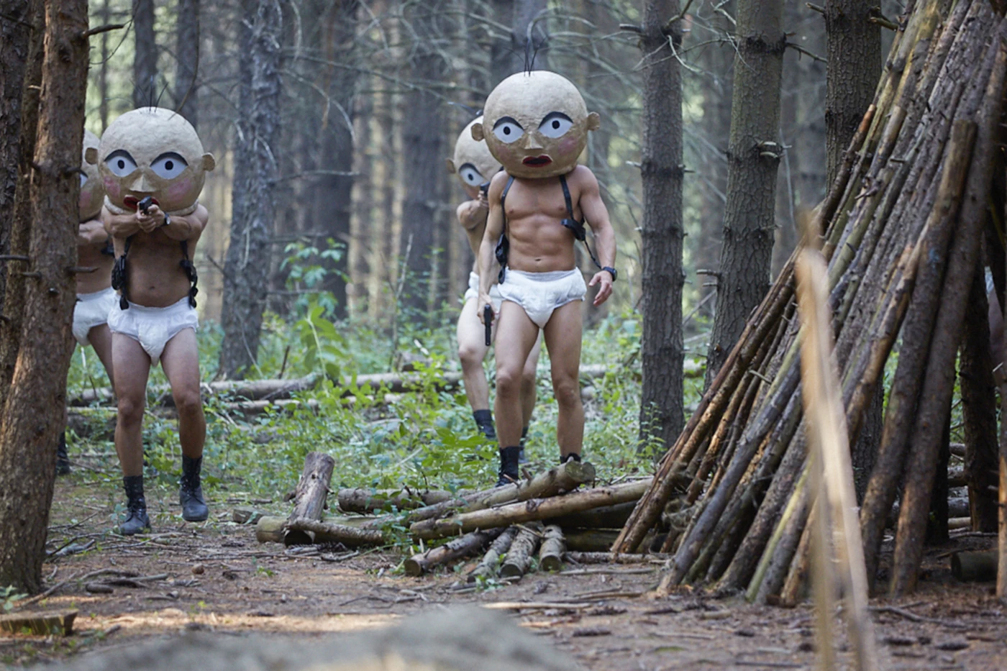
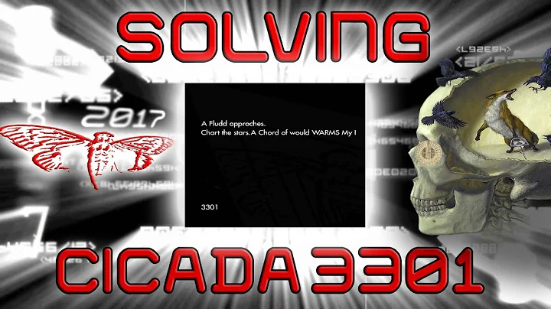
Misrepresentation in Popular Media
Inaccurate portrayals of Cicada 3301 in popular media
Youtube videos
Social Media
Fake Puzzles
News articles
Movie
Notes:
Puck speaker notes:
many people hear misconceptions about cicada 3301
fake puzzles + media promotion (gamejacking, scams)
news. yellow journalism. “solved it late” …movie
here’s the real story…

Slide 4
The Reality: Who is Cicada 3301?
What we have observed:
Refer to themselves as 3301 with a plural self-reference
They claim to be recruiting intelligent individuals
Have the resources to construct complex puzzles with global reach
Advocates of privacy and skilled with anonymity
Verify all messages with PGP 7A35090F
References to esoterica are a thematic choice
Common baseless claims:
Criminal organisation
Government agency
Advertising campaign
Cult / Religious origin
Liber Primus is solved
Puzzle releases since 2014
Notes:
Taiiwo, Nothing supernatural, but quality consistent.
More than basement neckbeard, but less than NWO. Enough money for inf, enough time for puzzle with no fin inc
Well int, skilled crypto priv prac, denounce crim act
Esoterica plays theming, never used in solution not otherwise obtainable by analysis > Clock
Speaker Notes (~1m15):
3301 is nothing supernatural, but the quality of the puzzles is consistently legendary
Clearly more than a basement dwelling neckbeard, but less than a new world order
Someone with enough money to rent infrastructure and disseminate posters globally
Enough free time to spend months putting together a treasure trail with no clear financial motivation
Well intentioned and clearly skilled in cryptography and privacy practice
They have gone out of their way to denounce criminal activity of any kind
Whilst esoterica plays a strong role in theming, has never been used in a solution that could not otherwise have been obtained by factual analysis
Taiiwo - Intention:
Fully explain 3301.
Points to elaborate on:
3301 is a group focused on promoting digital freedoms and security.
Intention:
This slide is for the audience members that have not heard of 3301, and to lay a foundation for those with vague or wild notions of their identity.

Slide 5
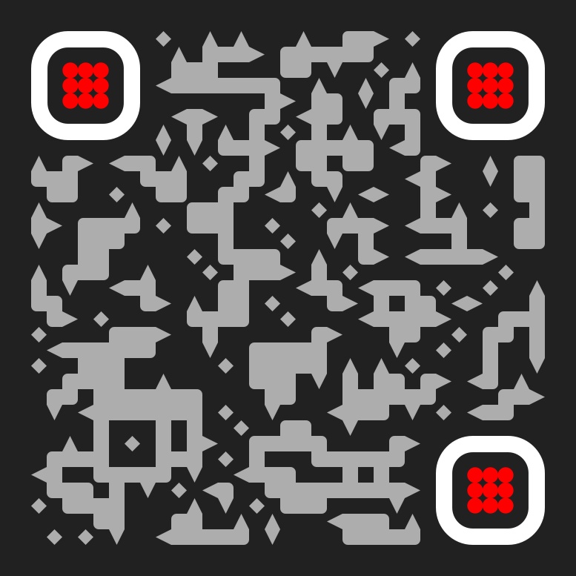
The Leaked Email
-----BEGIN PGP SIGNED MESSAGE-----
Hash: SHA1
DO NOT SHARE THIS INFORMATION!
Congratulations. Your testing has finally come to an end. We hope you have enjoyed
the "vacation" over the last few weeks. You will be very busy now should you choose
to join us.
There are two final steps, although there won't be any hidden codes, or secret messages,
or physical treasure hunts. This first of these is only honesty. We have always been
honest with you, and we shall continue to be honest with you. And we expect you to be
honest with us in return.
You have all wondered who we are, and so we shall now tell you : We are an international
group. We have no name. We have no symbol. We have no membership rosters. We do not
have a public website, and we do not advertise ourselves. We are a group of individuals
who have proven ourselves. Much like you have by completing this recruitment contest.
And we are drawn together by common beliefs. A careful reading of the texts used in
the contest would have revealed some of these beliefs : that tyranny and oppression
of any kind must end; that censorship is wrong; and that privacy is an inalienable right.
We are not a "hacker" group. Nor are we a "warez" group. We do not engage in illegal
activity, nor do our members. If you are engaged in illegal activity, we ask that you
cease any and all illegal activities or decline membership at this time. We will not
ask questions if you decline; however, if you lie to us we will find out.
You are undoubtedly wondering what it is that we do. We are much like a "Think Tank" in
that our primary focus is on researching and developing techniques to aid the ideas we
advocate : liberty, privacy, security. You have undoubtedly heard of a few of our past
projects. And if you choose to accept membership, we are happy to have you on board to
help with future projects.
“
Read it here
We look forward to hearing from you.
3301
-----BEGIN PGP SIGNATURE-----
Version: GnuPG v1.4.11 (GNU/Linux)
iQIcBAEBAgAGBQJRMuCKAAoJEBgfAeV6NQkPjCoQALzk/jfmJQbuGxu4jI++cR77
hJiE9yOhTgNeDcKPNYv5xBbJJEKrvd35dZ2YhKG672Z7Zf2Y+1LkoNRtkqyFFHRX
mKASfYYFMg7kyL5+kNxe5EZvgECAC2lADhmI0cFxsWgnWEXO/KE++raJDJ3jBzW5
hwscmD0g/KpieZTONwLRmdOj6VRjKrBzVeQilxdaqXD9Np4/t3+SwoAjLvQeVmzK
9etICCa1OcycnQhr+LgBLOTgAw7qMfLMIISxahAxKpCOxQSeN/rph9PAgm/oumy4
5NOaomDlHTVwTx2jzeFnd+vvFU9xYatun3RyBwOpmwTukEjDG3ze/IsSEQ/OV/bP
j8d19uPMX69Tg/TogJSDRv4R2o5ASq0pXoI/OcJ/mBTEsP0ks2A0t+jw6uuT0HAi
k2EsQBBVZFAPxMPVUwLs8iZurqLCkSeXnGYOElspm8RVAY+9r1GSNjo3QkoTJSPy
Yx9CHzVzD6z3RRHHAgkf2tQsadRS5qxijaBEV64J/JLl8qKzf4tqXVoL4rV4FkrN
VAABvpAjbZTWtu7VJJkvJhPseL8HJjcvdCadMElKZ6paaIj45mfYeIov0mbbCDQH
m7ZzOdWqmEOIXfMsCoAGlqd7wY0DAsLhxmH3ks/wkURf+/qboFuZO9y5mEoaj6xO
vJB0iPO0eCsuOQCbn6rr
=e3lt
-----END PGP SIGNATURE-----
“
Notes:
Clockwork speaker notes
they told us themselves
2leaked pgp verified message
3301 explains who they are, what they believe in, and what they do

Slide 6
Key Points From The Leaked Email
“We are an international group.”
“We are drawn together by common beliefs … censorship is wrong and ... privacy is an inalienable right.”
“We are much like a think tank”
“The ideas we advocate: Liberty, Privacy, Security”
Read it here
Notes:
Clockwork -“Think Tank” like international group -rnding techniques that forward their beliefs of: - liberty privacy and freedom.

Slide 7
Similarities with Cypherpunk Philosophies
Cypherpunk Mindset - “Privacy is necessary for an open society in the electronic age…freedom of speech, even more than privacy, is fundamental to an open society…Privacy in an open society also requires cryptography…Cypherpunks deplore regulations on cryptography, for encryption is fundamentally a private act…” - Eric Hughes Cypherpunk Manifesto
“For privacy to be widespread it must be part of a social contract. People must come and together deploy these systems for the common good. Privacy only extends so far as the cooperation of one's fellows in society.”
3301’s puzzles actively extend the range of people deploying privacy ensuring systems
Notes:
Clockwork: Stated beliefs and goals appear inspired, and aligned with : - cypherpunk philosophies (L.P.F) - goals to further an open society secured by privacy tool use and awareness.

Slide 8
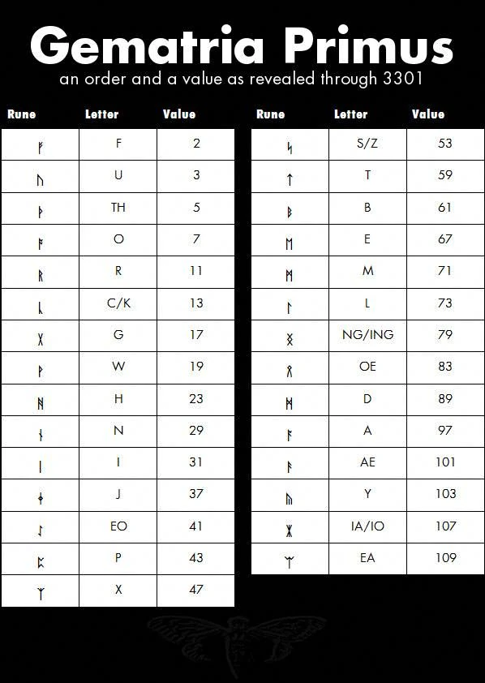
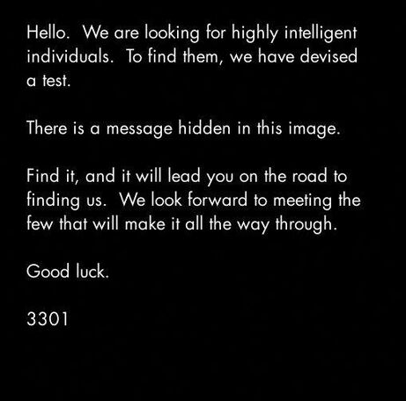
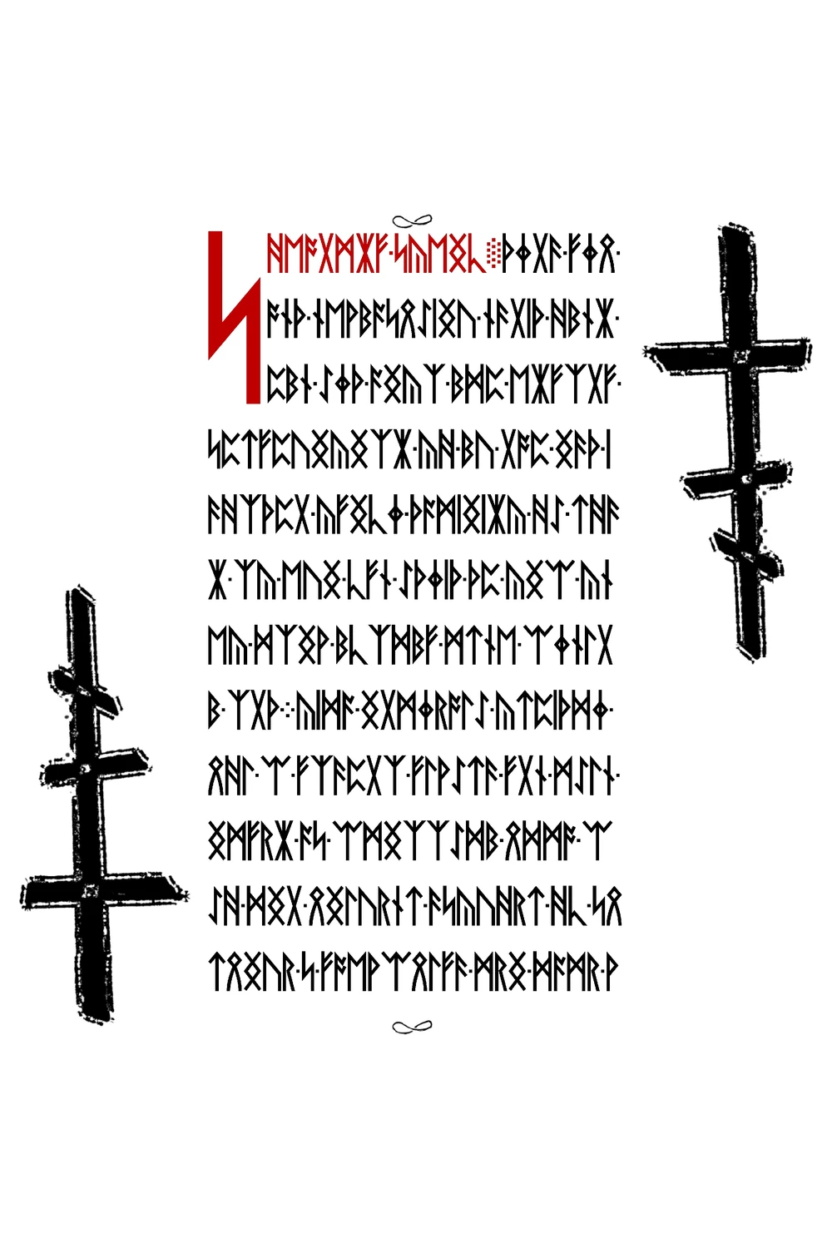
The Puzzle Timeline
The Grand Entrance
PGP Signed messages
Hidden services
Phone numbers
Cracking RSA keys
Global Posters
The Publication of The Liber Primus
17 pages of solved runes
Cracking RSA keys (again)
Interconnectedness
The 58 page ‘LP2’
The deep web hash
2013
Now
2012
2014
Round Two
Instar Emergence
Gematria Primus
CicadaOS
Web console
Global posters (again)
Notes:
Art
-General overview of the puzzles
-Express their scale, complexity, & difficulty
-Keep the story moving
-CPV for more detail
-Highlight reel
—--------------------------

Slide 9
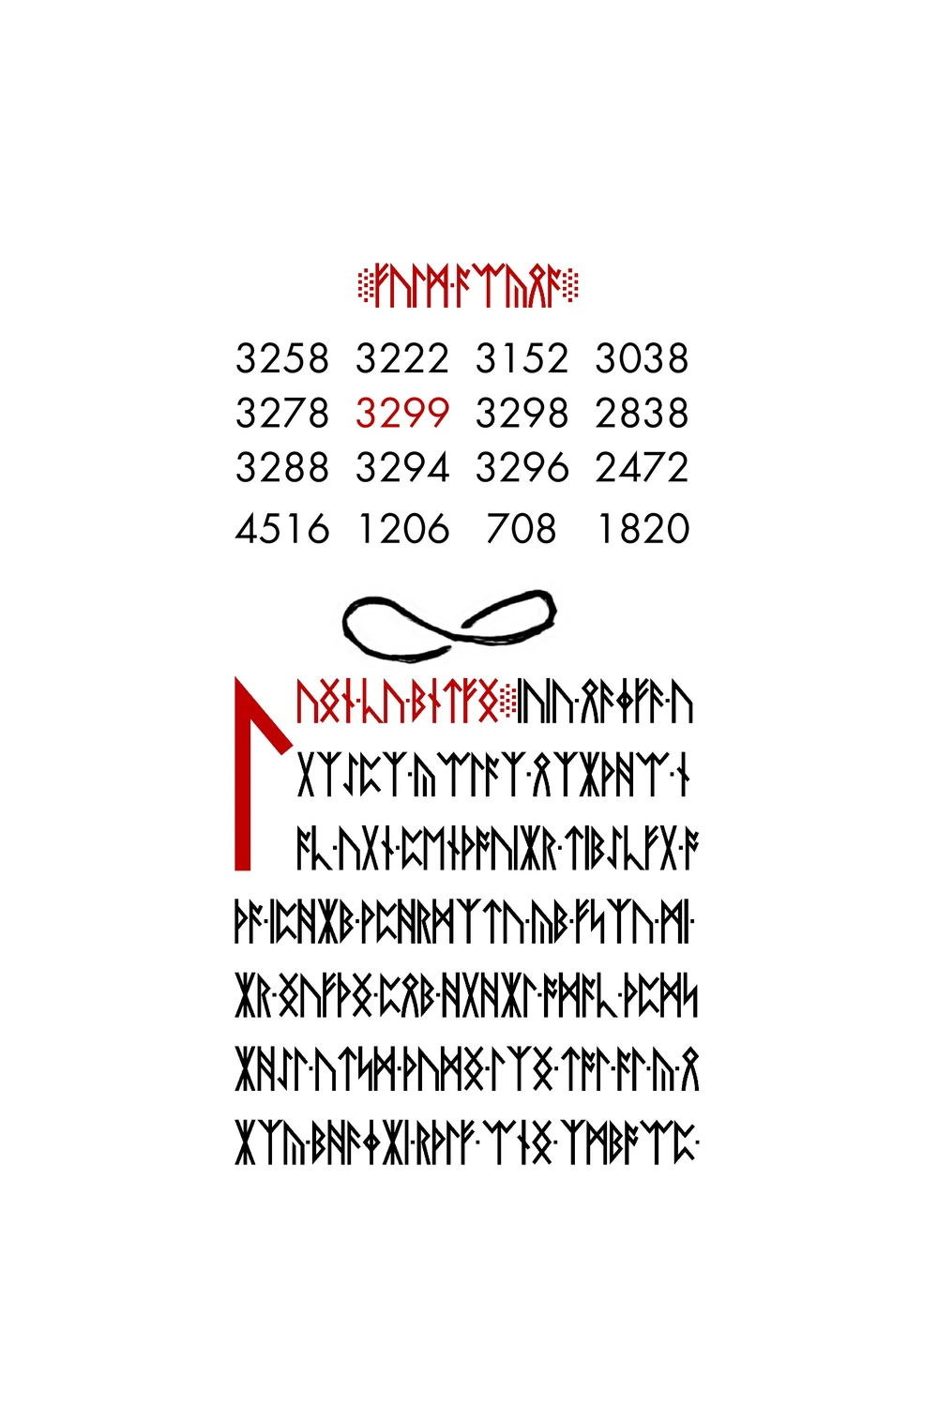
The Unsolved Step: Liber Primus
In May 2014, the latest step was released: A 58-page digital book of elder futhark runes.
Two pages were solved immediately; the rest have resisted thousands of attempts.
Pages are uniformly sized JPG files
Some pages are greyscale
Runes are encrypted
Normal statistical distribution
Repeating bi-grams have a high frequency
Notes:
Taiiwo - So after 3 years puzzles, 2014 remains unsolved. Scale of release was massive comparatively, immediately apparent step harder than before
Puzzle approached from different angles, runes, files, marginalia (orthadox, mobius)
The last 2 pages were solved immediately, one not encrypted no instruciton, page 56 much more direct
Explain the current puzzle step, Liber Primus.
Points to elaborate on (1m 25s)
This book is HARD
After 3 years of carefully crafted puzzles, the 2014 step of the puzzle remains unsolved
The scale of the release was overwhelming for many
Noticeable lack of tangible leads
Step immediately appeared harder than before
Different approaches used
Runes
Files
Marginalia
Final two pages were decrypted (56, 57)
One was not encrypted, but contained no clear instruction (57)
Transition to DWH slide

Slide 10
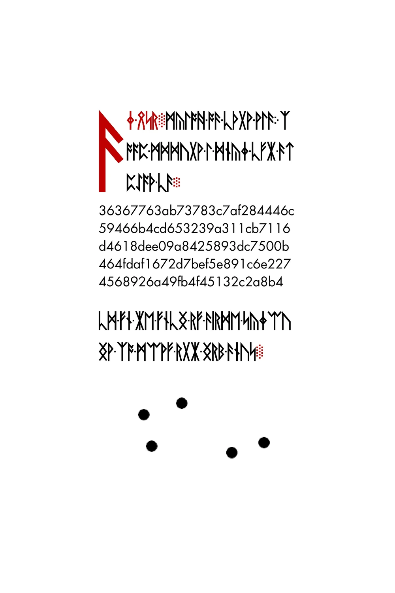
Page 56 - The Deep Web Hash
AN END - WITHIN THE DEEP WEB, THERE EXISTS A PAGE THAT HASHES TO:
512 bit hash
128 character hex
Relatively low value
IT IS THE DUTY OF EVERY PILGRIM TO SEEK OUT THIS PAGE.
Notes:
Taiiwo - Decrypted totient (stream prime) F int, page instructs to search deep web for page that hashes to 512 bit hash
Hash no necessarily SHA512, many 512bit hashes are considered such as Blake and MD6
In 2017 vuln was found allowing us to disclose unlisted hidden services as they are broadcast to the network
This piqued the interest of NEU’s honion, but despite hashing around 90% of the unindexed hidden services no page was found
Broader stroked approaches, browser extension 3301 Hash Alarm, hash pages, multi algo > Art
Introduce the DWH, talk about significance and touch on theories
Speaker Notes:
Decrypted with a totient shift, a stream cipher of prime numbers
F runes were skipped (interrupt)
The page is the only clear instruction we have from the Liber Primus
Instructs us to search for a page on the “deep web” that hashes to a 512 bit hash
Not necessarily SHA512 but could be:
BLAKE-512 - BLAKE2b - Elliptic Curve Only Hash* - FSB - Grøstl - JH - LSH(2015) - MD6
SHA3-512 - Spectral Hash - Streebog - SWIFFT - Whirlpool
TOR Search
2016 an exploit was found to search unindexed hidden services
The attempt was detected by a research project at Northeastern University
Had a honeypot of un-indexed hidden services (honions)
The exploit exposed public keys for hidden services
They were subsequently scraped and hashed
We were able to hash approximately 90% of the deep web while this vulnerability was exposed
Nothing was found
Browser extension hashes pages automatically
3301 Hash Alarm

Slide 11
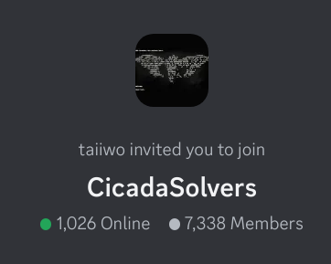


The CicadaSolvers Community
The path lies empty, but we are undeterred. Tens of thousands of people are still working to decrypt the runes and solve the internet’s hardest mystery.
The Discord community alone has well over 7,000 members, numerous ongoing solving attempts, and regular community events.
Notes:
Art - Segue to solvers part of talk
-Pursuing the impossible

Slide 12
Community Evolution
4Chan
IRC
Discord
The origin of the puzzle
Unpredictable community (toxic)
Liberated by the lack of moderation and accountability
Pre-existing community of ARG enthusiasts
Low accessibility means lower user count but higher average ability
Accessible privacy and open sourced clients
Low capability to moderate and organise content
Proprietary platform run by data miners
Huge user-base
Large set of moderation and organisational features
Strict terms of service
Notes:
Taiiwo - Tell the story how solvers came to be, started 4chan, garnered the attention of ARG IRC freenode and solvers IRC created soonafter main hub operations slv efforts
LP comp diff reduced numbers, 400 active users at peak down to 5-10, in 2019 OPs considered discord, tradeoff privacy for reach and conv featureset
Harness experience mitigate pitfalls managing community in past, discord operates with over 7000 active users thanks to unique operating structure >
Intention: We’re going to briefly tell the story of how solvers came to be, and transition into the “trials and tribulations” of running a community of this scale for the task of collaborative puzzle-solving
Speaker notes:
Tell the story of how cicadasolvers came to be
Started on 4chan
The puzzle garnered the attention of the ARG community in freenode IRC
The cicadasolvers IRC channel was created and quickly became the main hub of operations for solving efforts
Following the release of the Liber Primus, the community faced a huge reduction in numbers
Going from around ~400 active users at its peak, the IRC slowly lost members over time, with only 5-10 users rarely speaking
In 2019, the remaining operators of the Cicada Solvers channel got together to create a discord server, a highly controversial platform in the ARG community, especially one as privacy focused as cicadasolvers
Naturally people were skeptical about Discord’s data farming
The platform was proprietary
The user numbers were much higher
Features were more convenient
Solvers already relying on proprietary tools
Exchanging platform liberty for a greater reach, with a new set of values the discord community thrives at over 7,000 members
Newer platform and diverse user base allowed for a more professional, solving focused approach to community management

Slide 13
CicadaSolvers - What makes us different
Crowdsourced Information
Dedication to the sharing of progress and tools.
Stable Definition of Validity
No PGP = No Cicada.
Democratic Moderation
Clear rules, separation of personal interactions, and sanctions.
Inclusive Solving Atmosphere
Guide and teach rather than criticize and ridicule.
Structured Community Effort
Solving sessions, documentation processes, collaborative efforts, and community resources.
Notes:
Clockwork -Open sourced community - built upon pgp verified content that - cultivation of an inclusive/educational/and interactive environment with: - daily/weekly solving vc and organization of community resources

Slide 14
Our Main Challenges
Documentation
Fake Puzzles
Revolving Door
There are thousands of solving attempts every year, but very few are shared publicly. Furthermore, cryptanalyses of the current step are hard to reach.
Fake puzzles are pervasive in the community. People commonly create puzzles that utilizes 3301’s fame to target inexperienced solvers.
Solvers come and go all the time, so the active solving community is constantly adapting to new members and filling the shoes of old solvers.
Centralize analyses
Make documentation easier
Promote documentation
Flag fake puzzles without popularization
Enlist lost solvers
Avoid fake puzzles
Increase solver numbers
Maintain members
Notes:
Art -Solving barriers explained
-How to address them
-Overcoming obstacles together

Slide 15
The Documentation Challenge
Where do we find analyses of Liber Primus?
Resources in Discord server
Uncovering Cicada Wikia
Individual solvers’ efforts to centralize
How do we find past solving attempts?
Discord search feature
Specific channels for specific topics
Potentially building systems to handle attempts
WeKan / Trello
Forums
“Solving cicada” github
Notes:
Art
-Explain the issue of documenting solving attempts/analyses
-Organizational Complexity
-Project management

Slide 16
The Revolving Door
³ Leave
The motivation weakens from failure fatigue
¹ Join
Find the puzzle’s community with motivation to try solving
The Life-Cycle of a Solver
² Work
Attempt everything you are motivated to try
Notes:
Art
Join: (server collabs, CCast, defcon talk)
Work: we make tools to make it easier
Leave: Extend this by using friendliness and tools
Short and long term cycles
Revolving Door: People always come and go,
Self-perpetuating
Ship of theseus

Slide 17
Our Main Advantages
Large Community
Organization of Manpower
Active Tool Development
With thousands of members in our main Discord server, we always have multiple ongoing solving attempts.
With such a large community, we have developed strategies to optimize collaborative solving.
Solvers have streamlined the solving process through the creation of tools.
How does community size correlate with member retention?
How do our community events work?
How do we share workload?
What tools do we have?
How do we make tools easier to build?
Notes:
Puck note:
our community has a lot going for it
thousands people. more people = more retention
voice sessions
open source tool development
some for cryptography

Slide 18
Benefits of Our Community’s Size
Constant flow of new attempts and people eager to learn
The more solvers there are, the easier it is for new solvers to stick around
Older solvers can help out newer solvers
More motivation to solve when there are other people
More solvers → more solving ideas → you are more likely to find an idea you like → more solving motivation
Notes:
Puck note:
more people = more attempts
more people = more retention
mentors
“hype” encouragement

Slide 19
Organization of Manpower
Voice Sessions
Weekly and monthly events since January 2020 where community members gather in a voice channel
Best place to share ideas and solve together
Teaming up on solving
Voice sessions allow for sharing of workload
Delineation of tasks
Vet ideas
Notes:
Puck note: -voice sessions
specific for… serious solving, sharing ideas, art + literature
been improving constantly, come college we’ll have 3 active hosts
accessible: anyone can host

Slide 20
The Creation and Usage of Tools
Tools we have
Cyberchef adaptation - General tool for ciphers adapted to support runes
TaiiwoBot (CicadaBot) - Discord and IRC bot for rapid prototyping and more
Many specialized scripts to run tests and ciphers
3301 Hash alarm - hashes browser pages automatically
Many more - Cataloguing these tools is a project of it's own
Making tool development easier
Taiiwo’s cicada library - OOP Python library for rune conversion and more
Open source culture
Notes:
One area try cultivate organisation community tools and resources. Tool creation common focal point burnt solvers. Goal coodinate efforts comprehensive solving suite
Much like the recent breakthrough 54 year old z340 zodiac, production customised tools can unlock progress many years of extensive search
Challenge is tools lack rune support. Community began dev tools allow both deep analysis and simply prototyping of ideas to those require no input browser extension
Suite to advance solvers goal for generalized resource unification
Taiiwo - Intention: bring up how we promote solving infrastructure through tool development
Common tendency for burnt out solvers is to create tools
Enabled a new goal: the organisation of a complete solving suite
Zodiac killer Z340 cipher tool ZKDecrypto
Many existing cryptography tools don't natively support the runic alphabet
Some tools allow deeply configurable manipulation
Some focus on simple, quick prototypes of ideas
Some require no input at all, such as the browser extension mentioned earlier
The overall goal is to make each solving attempt benefit from the previous - a rich library of tools and resources

Slide 21
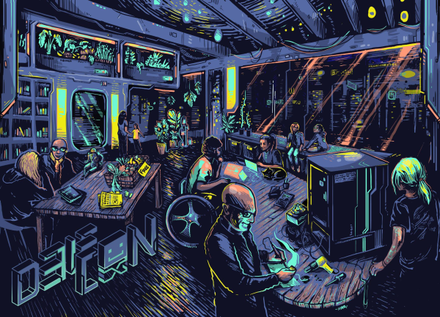
The Future Will Prevail
This year’s DEF CON theme is ‘The Future Will Prevail’
The CicadaSolvers community embodies this spirit
We have worked for years against all odds to solve the the unsolvable
If we don’t stay optimistic, we know we will give up
The future will prevail because people are learning now
Notes:
Art/Clockwork
-Link DEFCON theme with CicadaSolvers’ mission
-“The Future Will Prevail” philosophy is what keeps us going
-People have grown through CicadaSolvers

Slide 22
An End
Recap
Overview of Cicada 3301
Puzzle disinformation
The Liber Primus and the deep web hash
The CicadaSolvers community
Our approach to collaborative puzzle-solving
The future will prevail
Important Links
Uncovering Cicada Wikia
cicada.gq/discord
github.com/cicada-solvers
Notes:
Intention:
leave a recap slide for people to think of questions on
END OF SLIDE. SAY THANKS AND ASK FOR QUESTIONS

